Slide 1
Probability

Slide 2
Questions
what is a good general size for artifact samples?
what proportion of populations of interest should we be attempting to sample?
how do we evaluate the absence of an artifact type in our collections?

Slide 3
“frequentist” approach
probability should be assessed in purely objective terms
no room for subjectivity on the part of individual researchers
knowledge about probabilities comes from the relative frequency of a large number of trials
  this is a good model for coin tossing
  not so useful for archaeology, where many of the events that interest us are unique…

Slide 4
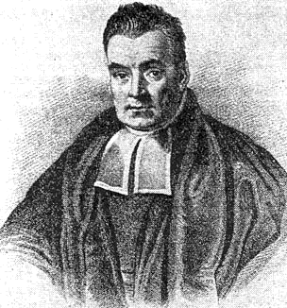
Bayesian approach
Bayes Theorem
  Thomas Bayes
  18th century English clergyman
concerned with integrating “prior knowledge” into calculations of probability
problematic for frequentists
  prior knowledge = bias, subjectivity…

Slide 5
basic concepts
probability of event = p
    0 <= p <= 1
    0 = certain non-occurrence
    1 = certain occurrence
.5 = even odds
.1 = 1 chance out of 10

Slide 6
basic concepts (cont.)
if A and B are mutually exclusive events:
  P(A or B) = P(A) + P(B)
  ex., die roll: P(1 or 6) = 1/6 + 1/6 = .33
possibility set:
  sum of all possible outcomes
  ~A = anything other than A
  P(A or ~A) = P(A) + P(~A) = 1

Slide 7
basic concepts (cont.)
discrete vs. continuous probabilities
discrete
  finite number of outcomes
continuous
  outcomes vary along continuous scale

Slide 8
discrete probabilities
.5
p
.25
HH
HT
TT
0

Slide 9
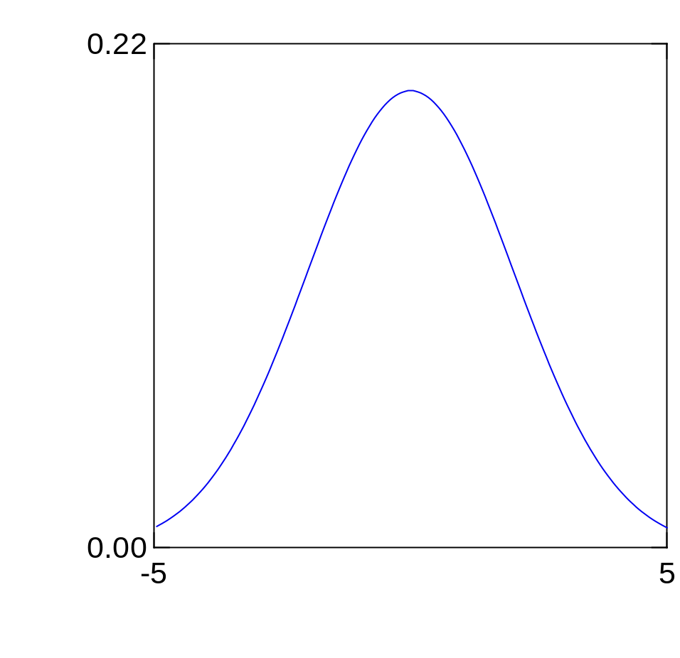
continuous probabilities
.2
.2
total area under curve = 1
but
the probability of any single value = 0
∴ interested in the probability assoc. w/ intervals
p
p
.1
.1
0
0

Slide 10
independent events
one event has no influence on the outcome of another event
if events A & B are independent
  then P(A&B) = P(A)*P(B)
if P(A&B) = P(A)*P(B)
  then events A & B are independent
coin flipping
  if P(H) = P(T) = .5 then
  P(HTHTH) = P(HHHHH) =
  .5*.5*.5*.5*.5 = .5⁵ = .03

Slide 11
if you are flipping a coin and it has already come up heads 6 times in a row, what are the odds of an 7th head?
.5
note that P(10H) < > P(4H,6T)
  lots of ways to achieve the 2nd result (therefore much more probable)

Slide 12
mutually exclusive events are not independent
rather, the most dependent kinds of events
  if not heads, then tails
  joint probability of 2 mutually exclusive events is 0
    P(A&B)=0

Slide 13
conditional probability
concern the odds of one event occurring, given that another event has occurred
P(A|B)=Prob of A, given B

Slide 14
e.g.
consider a temporally ambiguous, but generally late, pottery type
the probability that an actual example is “late” increases if found with other types of pottery that are unambiguously late…
P = probability that the specimen is late:
  isolated: P(T_{a}) = .7
  w/ late pottery (T_{b}): P(T_{a}|T_{b}) = .9
  w/ early pottery (T_{c}): P(T_{a}|T_{c}) = .3

Slide 15
conditional probability (cont.)
P(B|A) = P(A&B)/P(A)
if A and B are independent, then
  P(B|A) = P(A)*P(B)/P(A)
  P(B|A) = P(B)

Slide 16
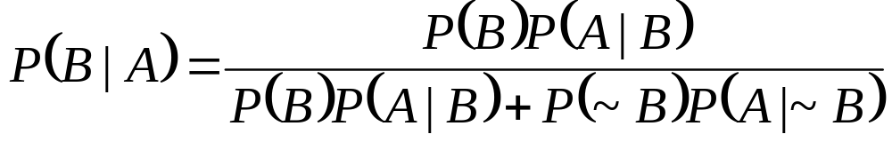
Bayes Theorem
can be derived from the basic equation for conditional probabilities

Slide 17
application
archaeological data about ceramic design
  bowls and jars, decorated and undecorated
previous excavations show:
  75% of assemblage are bowls, 25% jars
  of the bowls, about 50% are decorated
  of the jars, only about 20% are decorated
we have a decorated sherd fragment, but it’s too small to determine its form…
what is the probability that it comes from a bowl?

Slide 18
 | bowl | jar
dec. | ?? |  | 50% of bowls 20% of jars
undec. |  |  | 50% of bowls 80% of jars
 | 75% | 25%
can solve for P(B|A)
events:??
events: B = “bowlness”; A = “decoratedness”
P(B)=??; P(A|B)=??
P(B)=.75; P(A|B)=.50
P(~B)=.25; P(A|~B)=.20
P(B|A)=.75*.50 / ((.75*50)+(.25*.20))
P(B|A)=.88

Slide 19
Binomial theorem
P(n,k,p)
  probability of k successes in n trials
  where the probability of success on any one trial is p
  “success” = some specific event or outcome
  k specified outcomes
  n trials
  p probability of the specified outcome in 1 trial

Slide 20
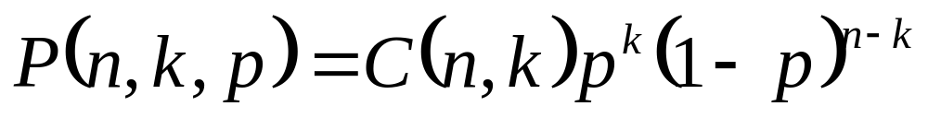
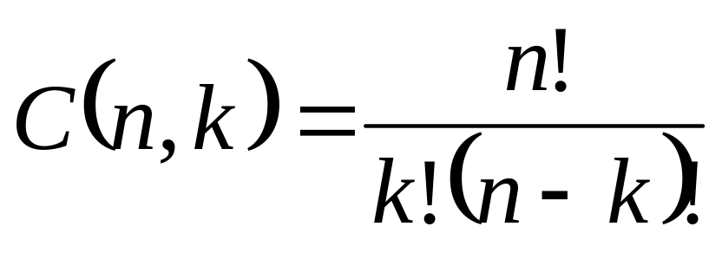
where
n! = n*(n-1)*(n-2)…*1 (where n is an integer)
0!=1

Slide 21
misc. useful derivations from BT
if repeated trials are carried out:
  mean successes (k) = n*p
  sd of successes (k) = √npq (note: q=1-p)
  (really only approximated when trials are repeated many times…)
k=0; P(n,0,p)=(1-p)^{n}

Slide 22
binomial distribution
binomial theorem describes a theoretical distribution that can be plotted in two different ways:
  probability density function (PDF)
  cumulative density function (CDF)

Slide 23
probability density function (PDF)
summarizes how odds/probabilities are distributed among the events that can arise from a series of trials

Slide 24
ex: coin toss
we toss a coin three times, defining the outcome head as a “success”…
what are the possible outcomes?
how do we calculate their probabilities?

Slide 25
coin toss (cont.)
how do we assign values to P(n,k,p)?
  3 trials; n = 3
  even odds of success; p=.5
  P(3,k,.5)
  there are 4 possible values for ‘k’, and we want to calculate P for each of them
k
0 | TTT
1 | HTT (THT,TTH)
2 | HHT (HTH, THH)
3 | HHH
“probability of k successes in n trials
where the probability of success on any one trial is p”

Slide 26
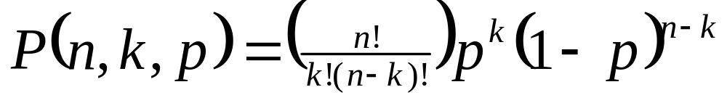
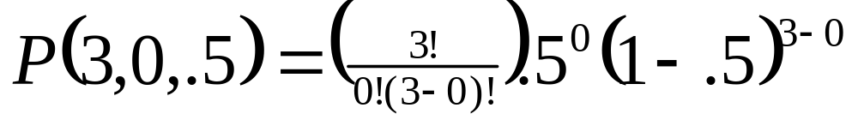
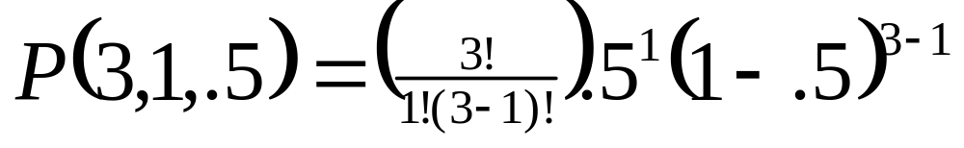
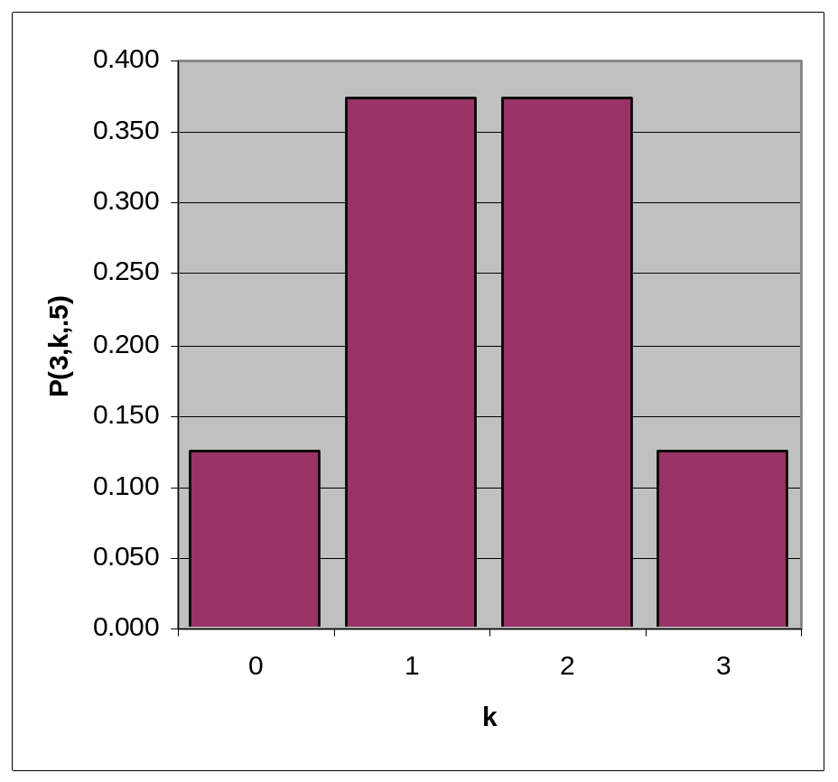

Slide 27
practical applications
how do we interpret the absence of key types in artifact samples??
does sample size matter??
does anything else matter??

Slide 28
example
we are interested in ceramic production in southern Utah
we have surface collections from a number of sites
  are any of them ceramic workshops??
evidence: ceramic “wasters”
  ethnoarchaeological data suggests that wasters tend to make up about 5% of samples at ceramic workshops

Slide 29
one of our sites → 15 sherds, none identified as wasters…
so, our evidence seems to suggest that this site is not a workshop
how strong is our conclusion??

Slide 30
reverse the logic: assume that it is a ceramic workshop
new question:
  how likely is it to have missed collecting wasters in a sample of 15 sherds from a real ceramic workshop??
P(n,k,p)
  [n trials, k successes, p prob. of success on 1 trial]
P(15,0,.05)
  [we may want to look at other values of k…]

Slide 31
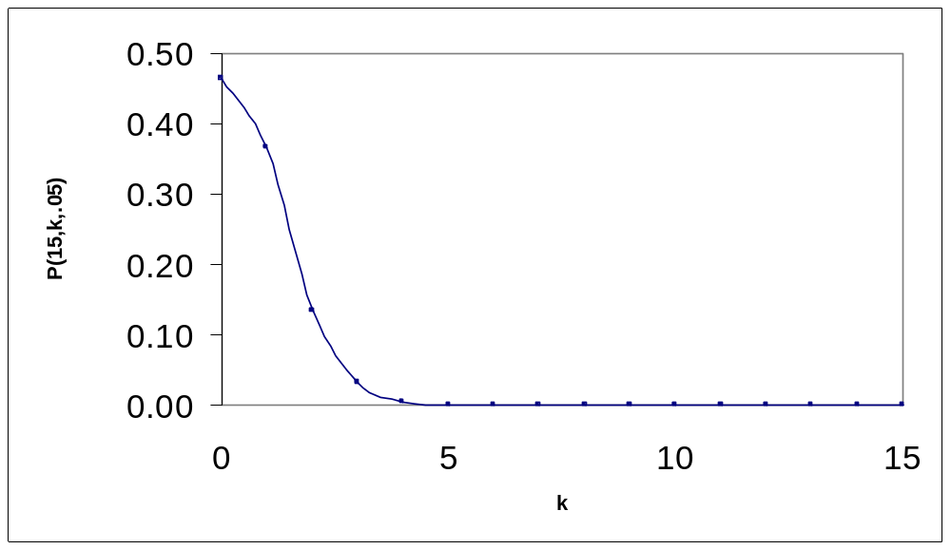
k | P(15,k,.05)
0 | 0.46
1 | 0.37
2 | 0.13
3 | 0.03
4 | 0.00
…
15 | 0.00

Slide 32
how large a sample do you need before you can place some reasonable confidence in the idea that no wasters = no workshop?
how could we find out??
we could plot P(n,0,.05) against different values of n…

Slide 33
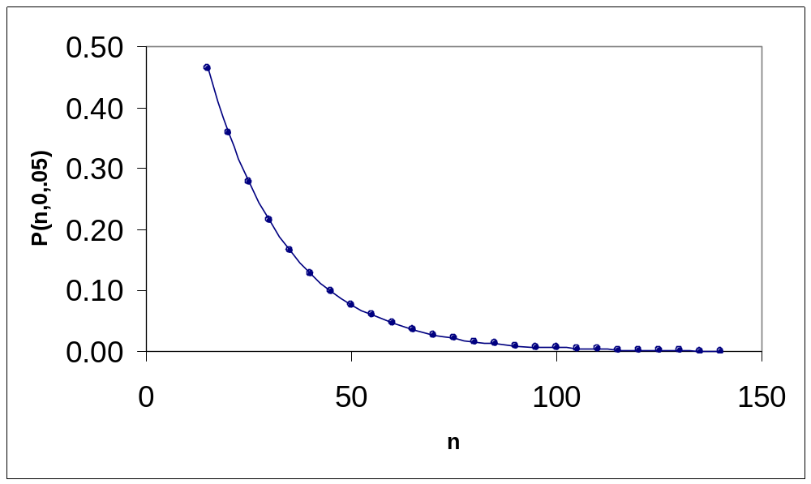
50 – less than 1 chance in 10 of collecting no wasters…
100 – about 1 chance in 100…

Slide 34
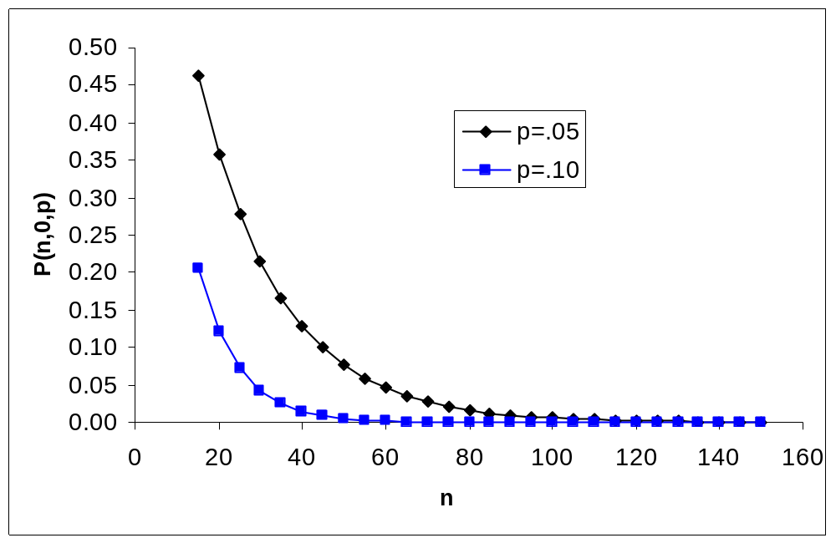
What if wasters existed at a higher proportion than 5%??

Slide 35
so, how big should samples be?
depends on your research goals & interests
need big samples to study rare items…
“rules of thumb” are usually misguided (ex. “200 pollen grains is a valid sample”)
in general, sheer sample size is more important that the actual proportion
large samples that constitute a very small proportion of a population may be highly useful for inferential purposes

Slide 36
the plots we have been using are probability density functions (PDF)
cumulative density functions (CDF) have a special purpose
example based on mortuary data…

Slide 37
Pre-Dynastic cemeteries in Upper Egypt
Site 1
  800 graves
  160 exhibit body position and grave goods that mark members of a distinct ethnicity (group A)
  relative frequency of 0.2
Site 2
  badly damaged; only 50 graves excavated
  6 exhibit “group A” characteristics
  relative frequency of 0.12

Slide 38
expressed as a proportion, Site 1 has around twice as many burials of individuals from “group A” as Site 2
how seriously should we take this observation as evidence about social differences between underlying populations?

Slide 39
assume for the moment that there is no difference between these societies—they represent samples from the same underlying population
how likely would it be to collect our Site 2 sample from this underlying population?
we could use data merged from both sites as a basis for characterizing this population
but since the sample from Site 1 is so large, lets just use it …

Slide 40
Site 1 suggests that about 20% of our society belong to this distinct social class…
if so, we might have expected that 10 of the 50 sites excavated from site 2 would belong to this class
but we found only 6…

Slide 41
how likely is it that this difference (10 vs. 6) could arise just from random chance??
to answer this question, we have to be interested in more than just the probability associated with the single observed outcome “6”
we are also interested in the total probability associated with outcomes that are more extreme than “6”…

Slide 42
imagine a simulation of the discovery/excavation process of graves at Site 2:
repeated drawing of 50 balls from a jar:
  ca. 800 balls
  80% black, 20% white
on average, samples will contain 10 white balls, but individual samples will vary

Slide 43
by keeping score on how many times we draw a sample that is as, or more divergent (relative to the mean sample) than what we observed in our real-world sample…
this means we have to tally all samples that produce 6, 5, 4…0, white balls…
a tally of just those samples with 6 white balls eliminates crucial evidence…

Slide 44
we can use the binomial theorem instead of the drawing experiment, but the same logic applies
a cumulative density function (CDF) displays probabilities associated with a range of outcomes (such as 6 to 0 graves with evidence for elite status)

Slide 45
n | k | p | P(n,k,p) | cumP
50 | 0 | 0.20 | 0.000 | 0.000
50 | 1 | 0.20 | 0.000 | 0.000
50 | 2 | 0.20 | 0.001 | 0.001
50 | 3 | 0.20 | 0.004 | 0.006
50 | 4 | 0.20 | 0.013 | 0.018
50 | 5 | 0.20 | 0.030 | 0.048
50 | 6 | 0.20 | 0.055 | 0.103

Slide 46
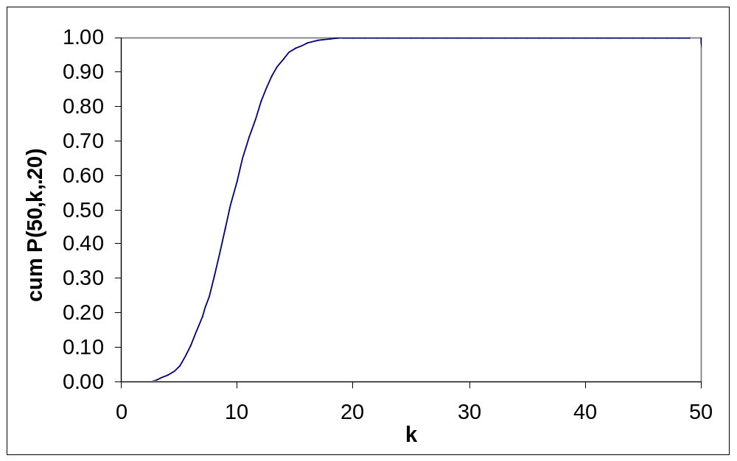

Slide 47
so, the odds are about 1 in 10 that the differences we see could be attributed to random effects—rather than social differences
you have to decide what this observation really means, and other kinds of evidence will probably play a role in your decision…

